Slide 1




UNIVERSITY OF BUEA
FACULTY OF ENGINEERING & TECHNOLOGY
2023/2024
CEF440: INTERNET PROGRAMMING AND MOBILE PROGRAMMING
UI DESIGN AND IMPLEMENTATION
OF A BIOMETRIC STUDENT ATTENDANCE RECORDING SYSTEM
Task 5
Presented by
Course Instructor
GROUP 12
DR. VALERY NKEMENI

Slide 2

Group 12 Members
NAME | MATRICULE
IHIMBRU ZADOLF ONGUM | FE21A203
CHE KASSINA KUM | FE21A158
NFOUA EUGENE MGBA | FE21A257
FONJI DANIEL KUKUH | FE21A194
EPIE MUKEH SANDRA | FE21A185

Slide 3

Content
INTRODUCTION
USER ROLES AND INTERFACE
WIREFRAME
CONCLUSION
TYPOGRAPHY DESIGN
PSYCHOLOGY OF COLOR
HOW THESE COLORS HELP

Slide 4

INTRODUCTION
UI design of biometric student attendance record is crucial for user engagement and ease of use. Key elements include a thoughtfully chosen color scheme for visual appeal, well-structured wireframes for intuitive navigation, clear typography for readability, and guided user path directions to enhance usability.

Slide 5
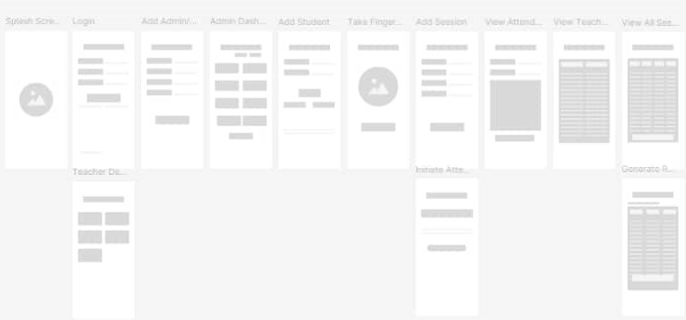
WIREFRAME
Wireframe is a basic visual representation of the user interface, focusing on the structure and, outlines the placement of key components

Slide 6

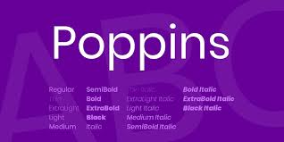
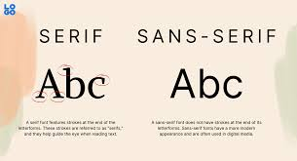
TYPOGRAPHY DESIGN
Typography design is the art and technique of arranging type to make written language legible, readable, and visually appealing in a digital or print layout.
PRIMARY FONT
SECONDARY FONT

Slide 7
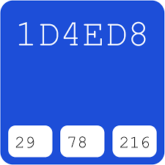

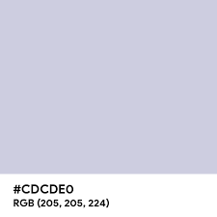
PSYCHOLOGY OF COLOR
Blue: Trust, calmness, reliability
White: Simplicity, clarity
Green: Growth, harmony, success
Primary color
Secondary color
Tertiary color

Slide 8
HOW THESE COLORS HELP
Enhancing Readability and Usability
Creating a Positive User Experience
Guiding User Actions
Maintaining Brand Consistency

Slide 9


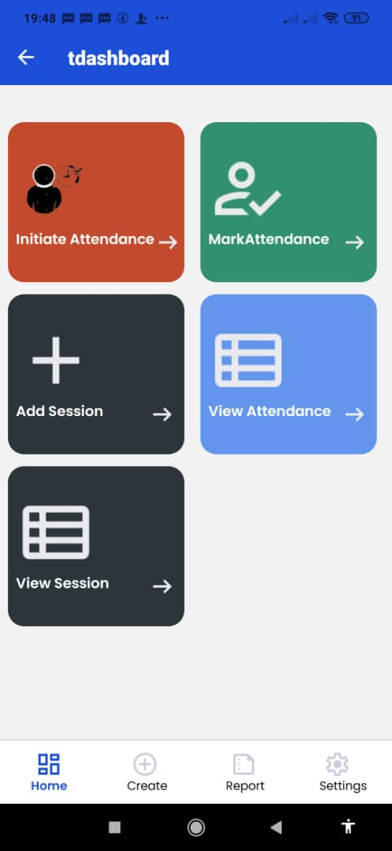
USER ROLES AND INTERFACE
Lecturer
Initiate Attendance
View Attendance
Mark Attendance
Generate Report
Add Session
View Session

Slide 10
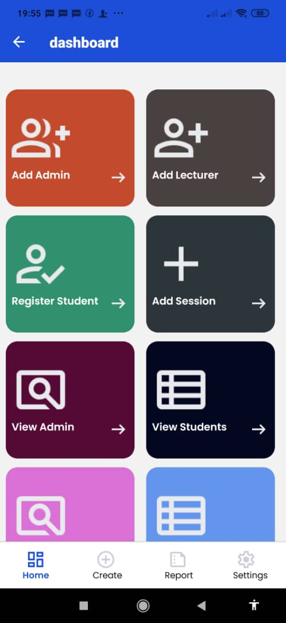
ADMINISTRATOR
Register Student
Register Teacher
View Attendance
Generate Report
View Student
Add Session
Add Administrator
View Session

Slide 11
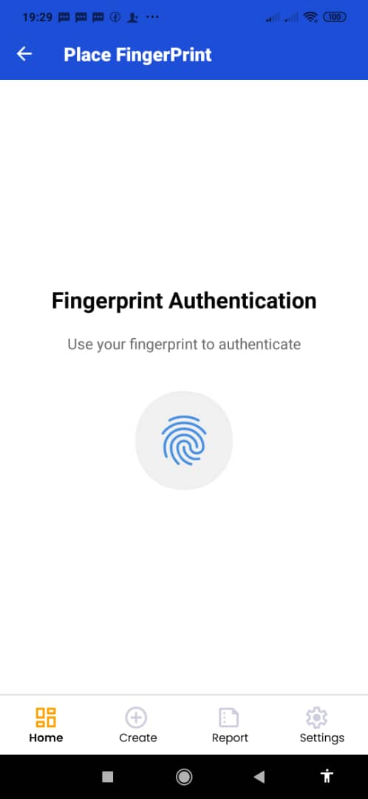
STUDENT
Mark Attendance
View Attendance

Slide 12
Conclusion
The deliberate choice of blue, white, and green for the UI design of a school attendance system is based on their psychological and functional attributes. . By thoughtfully integrating these colors, the school attendance system can achieve its goal of providing a reliable, clear, and motivating platform for managing attendance.

Slide 13
Thank you for keen attention

